Slide 1

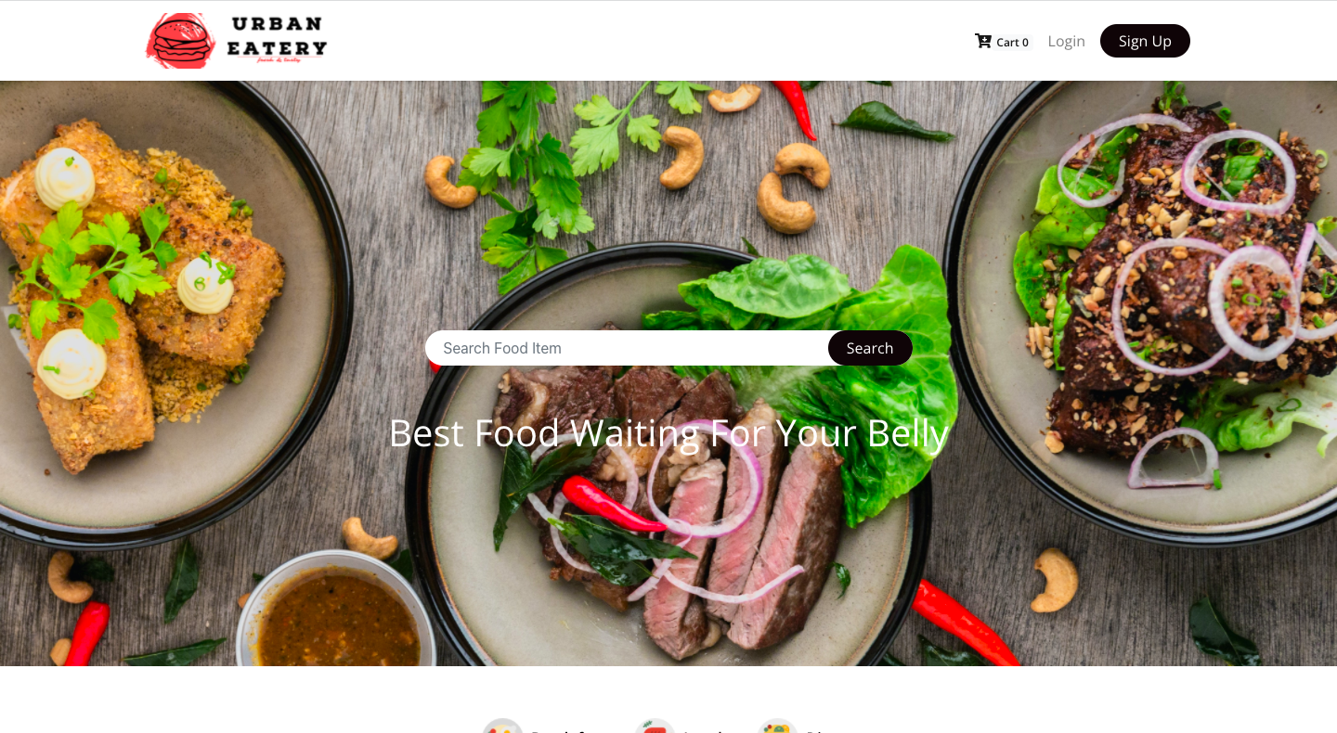
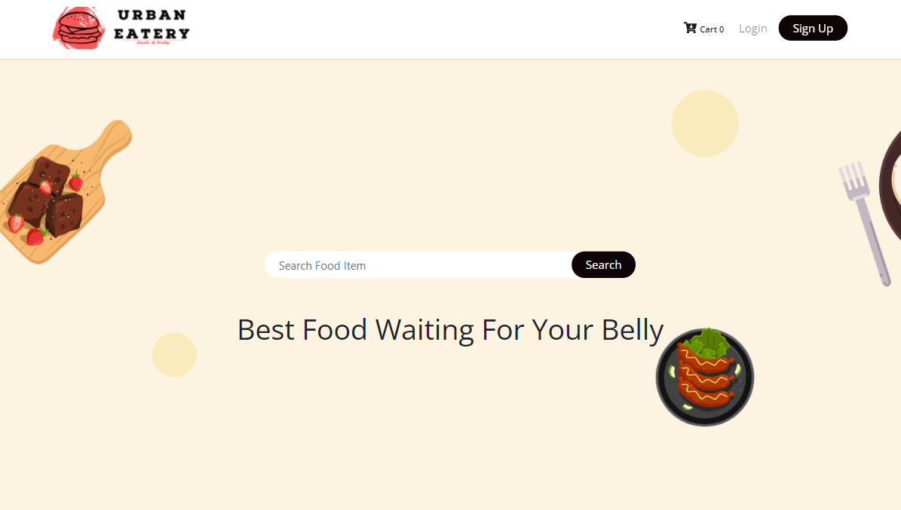

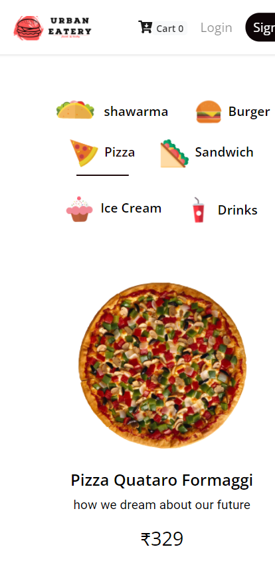
Urban
Eatery
“Good food for good moments”
Group: 3

Slide 2
Outline
The Problem
Solution Proposal
Component Description
Next Steps
Wireframes

Slide 3
The Problem

Slide 4
Problem statement
Lack of online presence of the local restaurants
Food services are being commercialised on a larger scale by bigger companies narrowing down the window for local restaurants.

Slide 5
What customers do today
Customers like to get the food delivered to their doorstep
The local markets lack the online presence.
So, in this online world the local shops have no direct connection with their immediate customers, where they can promote their food and share their side of story.

Slide 6
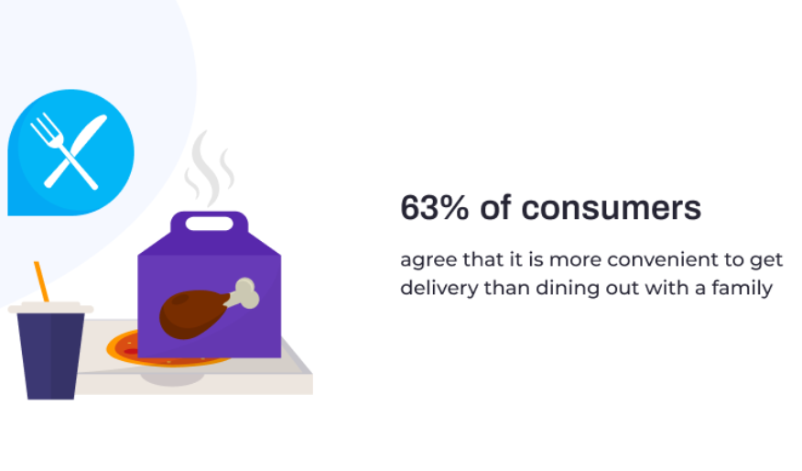
Ease of access
01
Users today are more inclined towards comfort due to time constraint

Slide 7
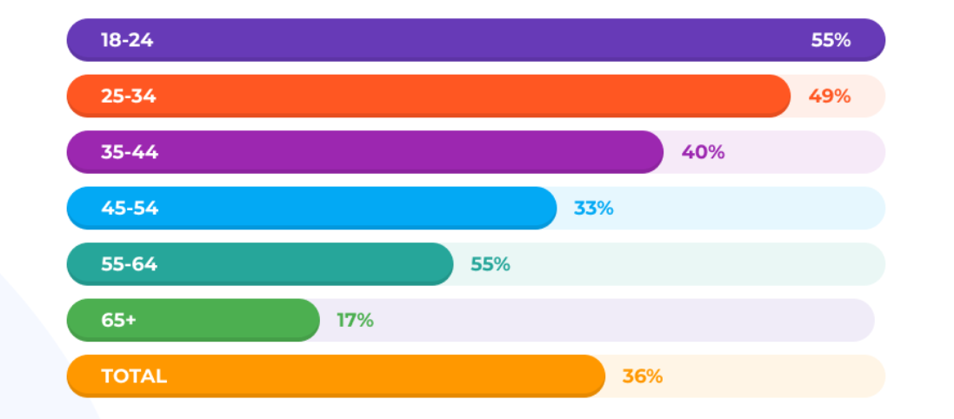
Online food demographics
02
The current demographics shows that our younger generation likes to deliver online to have the food delivered within their comfort zone

Slide 8

Testimonial
03
“From the consumer perspective, there’s nothing more convenient than having the restaurant come to them.”
Hudson Riehle
SVP, National Restaurant Association
Hudson Riehle, a pioneer in Research and Innovation service supports the long term growth of the online food industry.

Slide 9
Solution Proposal

Slide 10
Solution description
Urban Eatery is the app which will be made available to every local Restaurant or Dhaba without charging any money.
Our team has aimed to bring back the traditional food in trend rather than custom food capturing the market.
Local restaurants will be able to have their online presence to retain their glory.

Slide 11
Why it’s better than existing solutions
Existing etery applications are aimed at capturing the large market. This drives the food industry to produce custom designed food irrespective of local traditional food.
Traditional food is slowly taking recede, needs an urgent revival.
So, rather than focussing on capturing the maximum area of customers, Urban Eatery is aimed to help local restaurants to make their relation firm within their locality.
This will not only help them financially but also help to retain tradition, fraternity and equality.

Slide 12
Component description

Slide 13
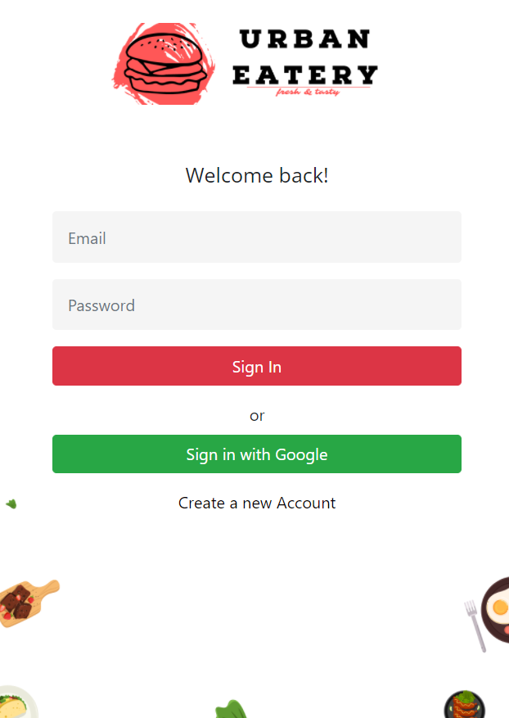
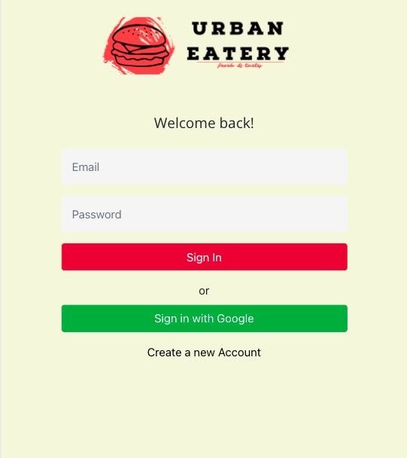
Login Page
Login
A login form with an option of email and password and
Sign in using Google
Using the firebase authentication

Slide 14
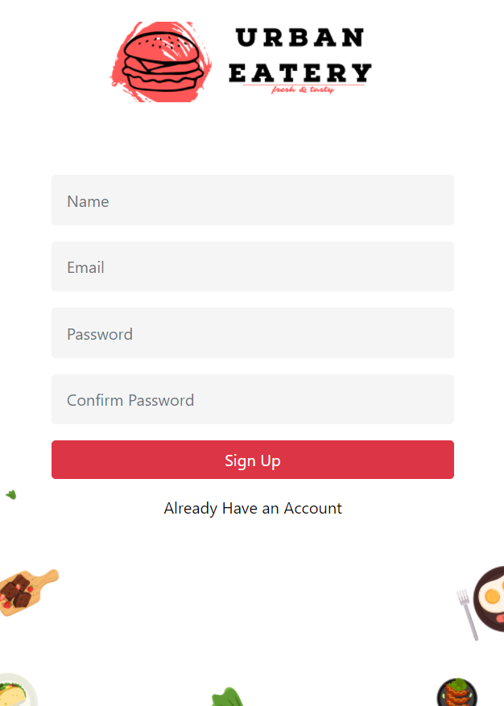
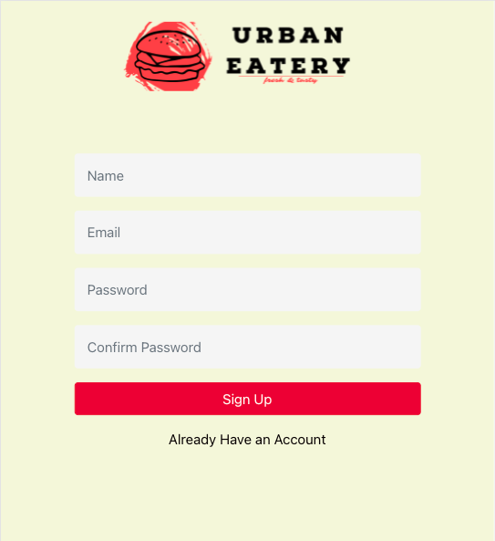
SignUp Page
SignUp
A form to collect the new users information
New users can register using email

Slide 15
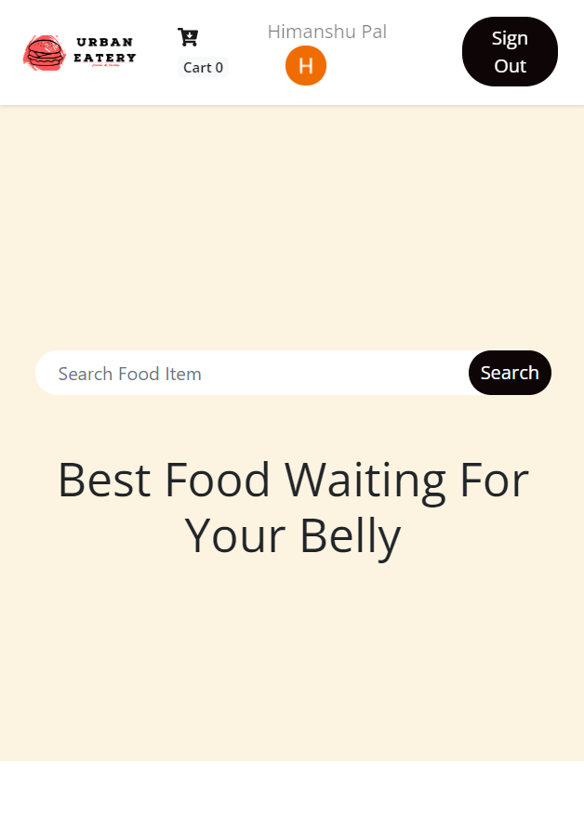
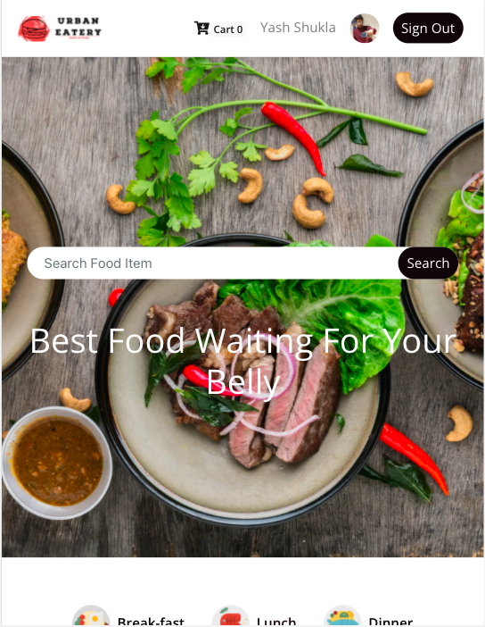
Home Page
Home Page
Home Page
Home
Header
Canvas (Search Component)
Search Result ( Shows search result)
Landing page of our application

Slide 16
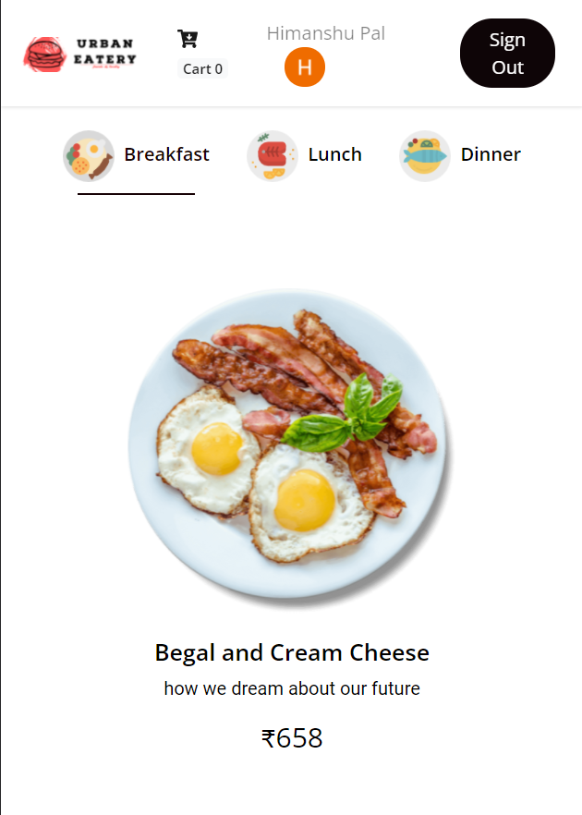
Home Page
Home Page
Food Display
Food Display
Header
Food (Filter breakfast, lunch & Dinner)
Food Item (Display food items)
It shows the food Items tile with it description and price

Slide 17
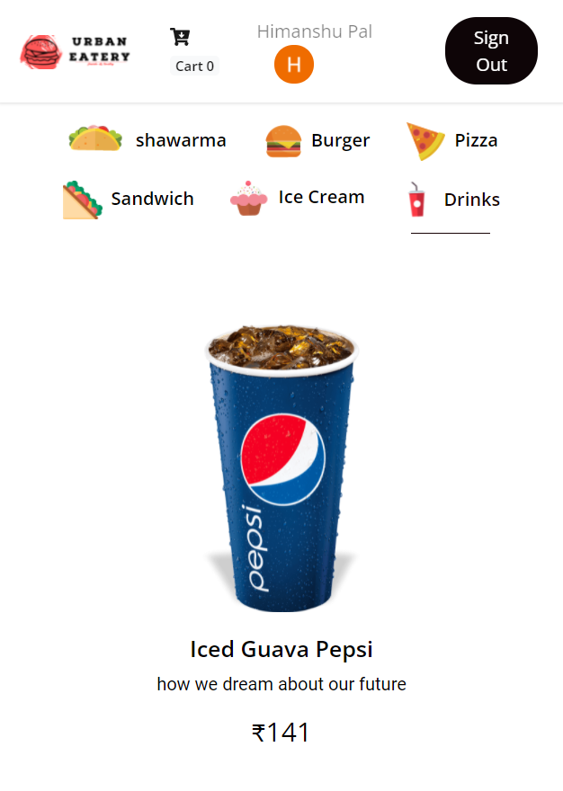
Home Page
Home Page
Filter Category-wise
Filter Category-wise
Header
Food (Filter breakfast, lunch & Dinner)
Food Item (Display food items)
Each food item can be filtered based on specific tag

Slide 18
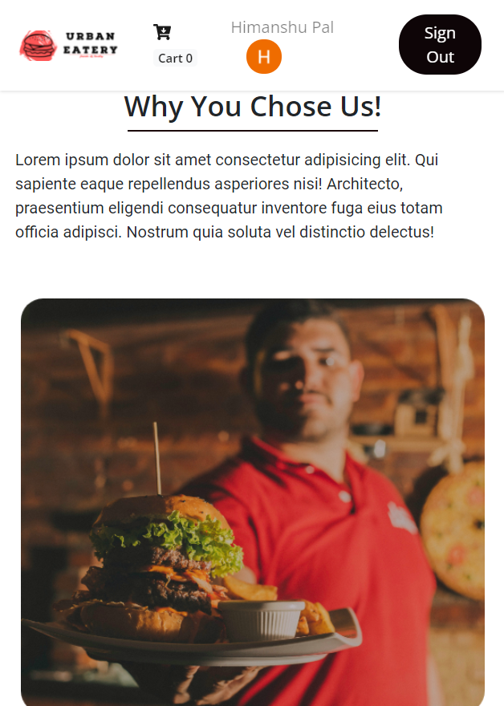
Home Page
Home Page
Blog Page
Blog
Blog
Blog Item
It chooses custom blogs on our page. We will publish our own blogs later.

Slide 19
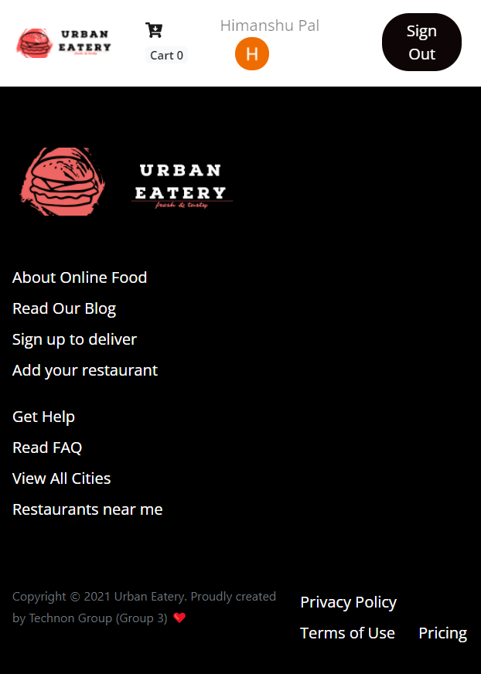
Home Page
Home Page
Footer
Footer
Providing the links to different pages

Slide 20
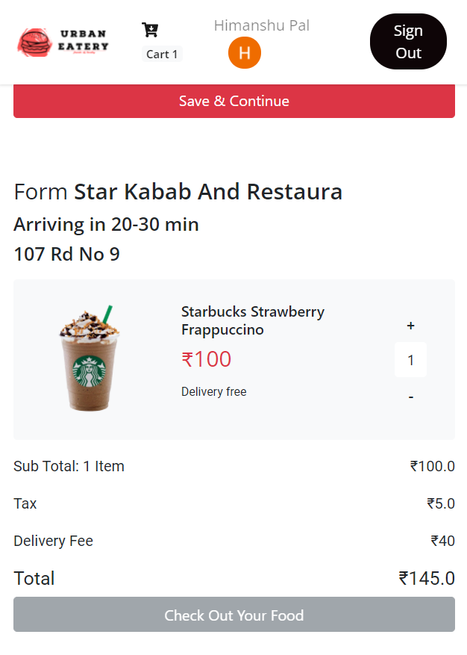
Home Page
Home Page
Checkout Page
Checkout page
Header
Provides a form to fill the delivery details
Shows the total price
Gives the flexibility to change the quantity in the cart

Slide 21
Next Steps

Slide 22
What next?
Adding payment gateway (Stripe)
Account page
Restaurant page
Past orders
Managing footer links and making appropriate pages for it

Slide 23
Wireframes

Slide 24
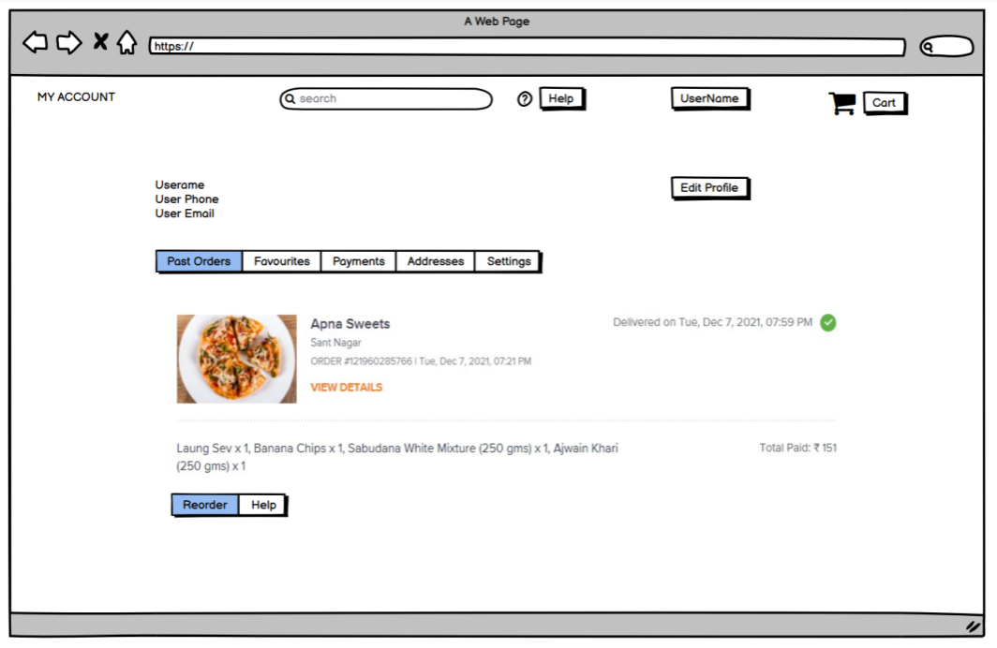
Account Page
Past order component in the account component

Slide 25
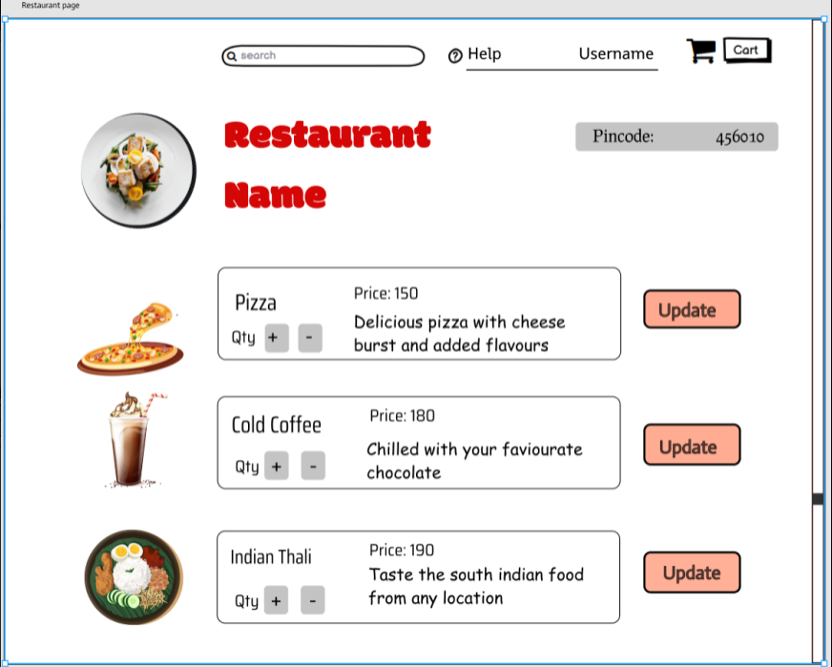
Restaurant Page

Slide 26
Contributors

Slide 27
Members Contribution
Yash Shukla (S20190010198)
Himanshu Pal (S20190010064)
Nishchay Verma (S20190010128)
Abhishek Jain (S20190010003)
Praveen Kumar Reddy (S20190010149)
Header - Footer + Blog + Routing + Integration
Food-detail + Shipment + Recommend + Get request
Login + Signup + Firebase Integration + Post & Delete
Banner + Search-Result + Logo + Image
Food Item collection + mock database + Not Found

Slide 28
Questions?

